Slide 1
Image Processing
Sergio Minera
Ivan Garcia
Samuel Holt
Harrison Hsieh
Alexander Ulrichsen

Slide 2

Image Conversions to FPGA
Used Python 3 to generate both .mem file and palette.mem file.
The mem file and palette file are used as memory map converter on the FPGA.
Takes an image and outputs the data of the image in hex text format.
Image has to have a low resolution to be able to get the correct output.
The number of color bits per pixel can be 4, 6, or 8.
The palette will be 12-bit in hex text format.

Slide 3
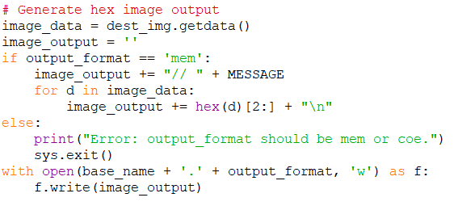
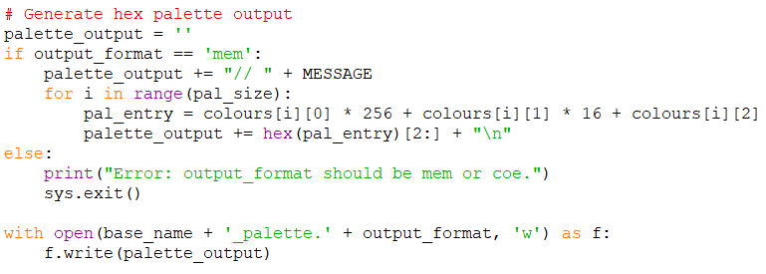
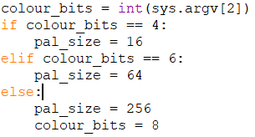
Code and Commands

Slide 4
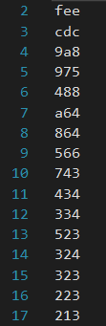
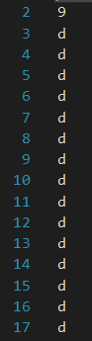
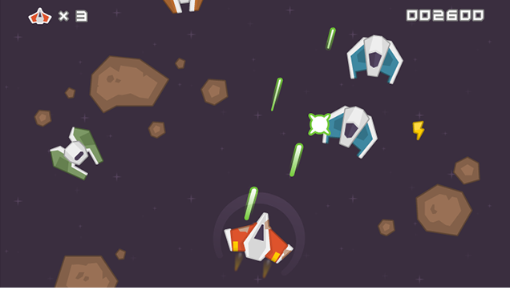
Mem and Palette Files
game.mem
Holds the location of the pixel and maps it to the palette file.
game_palette.mem
Holds all the possible colors for the game image.

Slide 5
Image to Memory to VGA
Load Image(.mem) into 2D Array
Resolution: 640 x 360
Depth = 640*360 = 230,400
Data Width = 12 bits
Number of unique colors
Address Width = 18 bits
2¹⁸ > 230,400 (Address every pixel)
VGA Output
Match .mem with palette
Each clock cycle defines one pixel.
VGA output prints picture after all pixels are defined.

Slide 6

Controlling Type of Image Processing
Implemented case statements controlled with a select input.
Select value is driven by 2 switches for a total of 4 case values.
One case statement controls which image will be used for image processing.
Second case statement controls the type of image processing used, whether the image will be greyscaled, inverted, encrypted or increased in brightness.

Slide 7
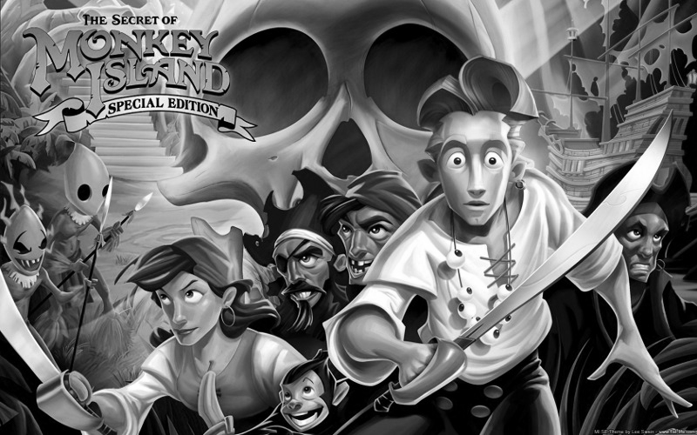
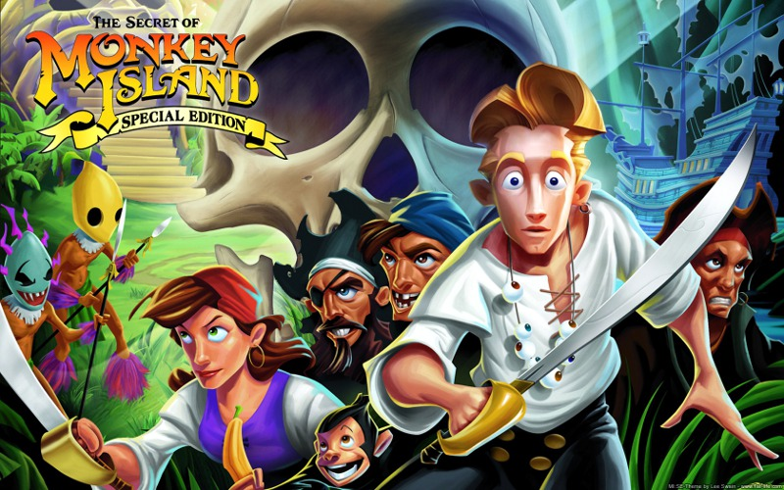
Greyscale Image Processing
FPGA obtains our color data from the image palette and .mem file and stores it into a 12 bit array.
This color array is later on divided in 3 separate 4 bit arrays that are used to store values of RGB, thus one of the three separate arrays represents the Red color channel, another Green color channel and the final one Blue color channel.
Greyscale is implemented by averaging these three channels together and assigning this average to each color channel, thus resulting into a grey image.

Slide 8
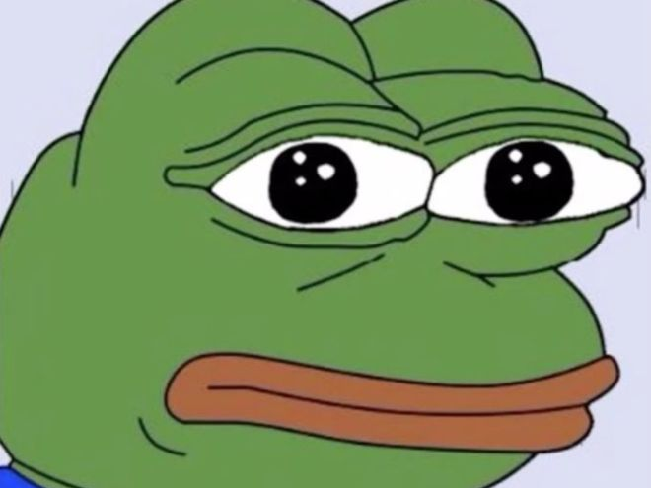
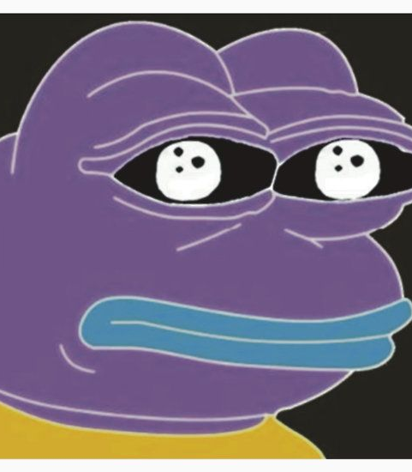
Inversion Image Processing
In a similar way to how greyscale is obtained, color data is stored and divided into the three RGB color channels.
Inversion is obtained by using the RGB data and finding the value on the other end of its color spectrum.
In our case, because each color channel is a 4 bit channel, we can invert its data by using its highest value (15) and subtracting our current color value, thus resulting in an inverted image.

Slide 9
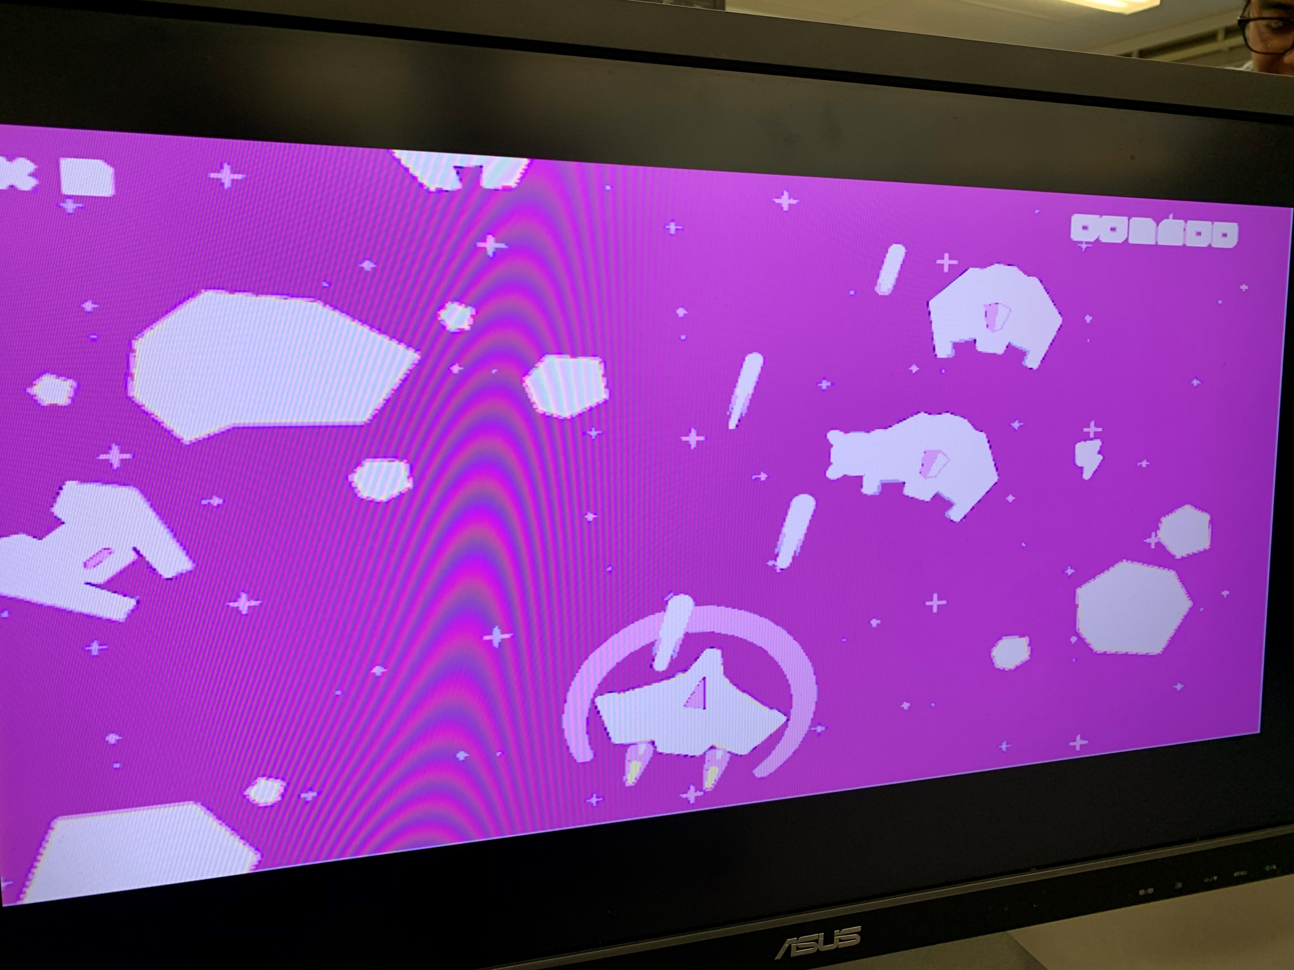
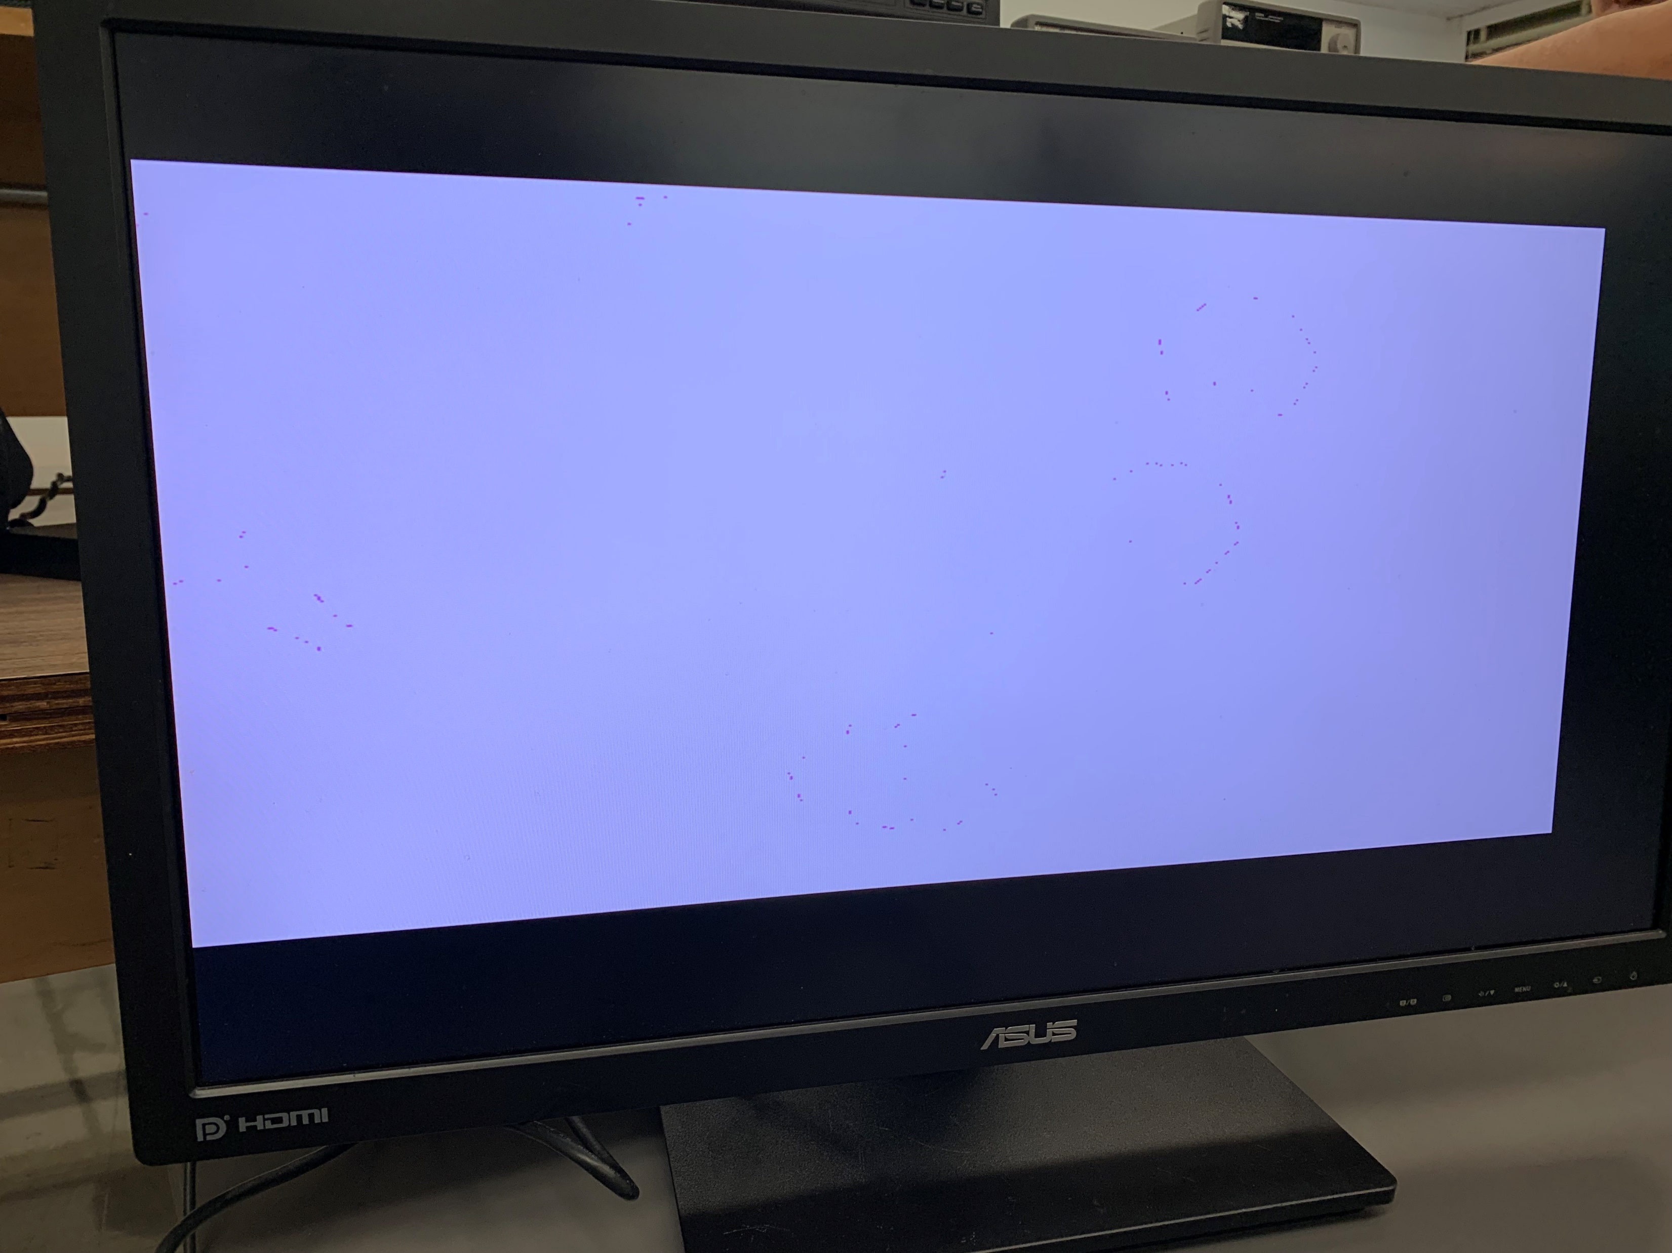

Adjusting Image Brightness
Brightness adjustments are made by using a multiplier on each of the color bits
Mapped this multiplier to 4 switches for 4-bit adjustment
Added condition to ensure values did not overflow

Slide 10
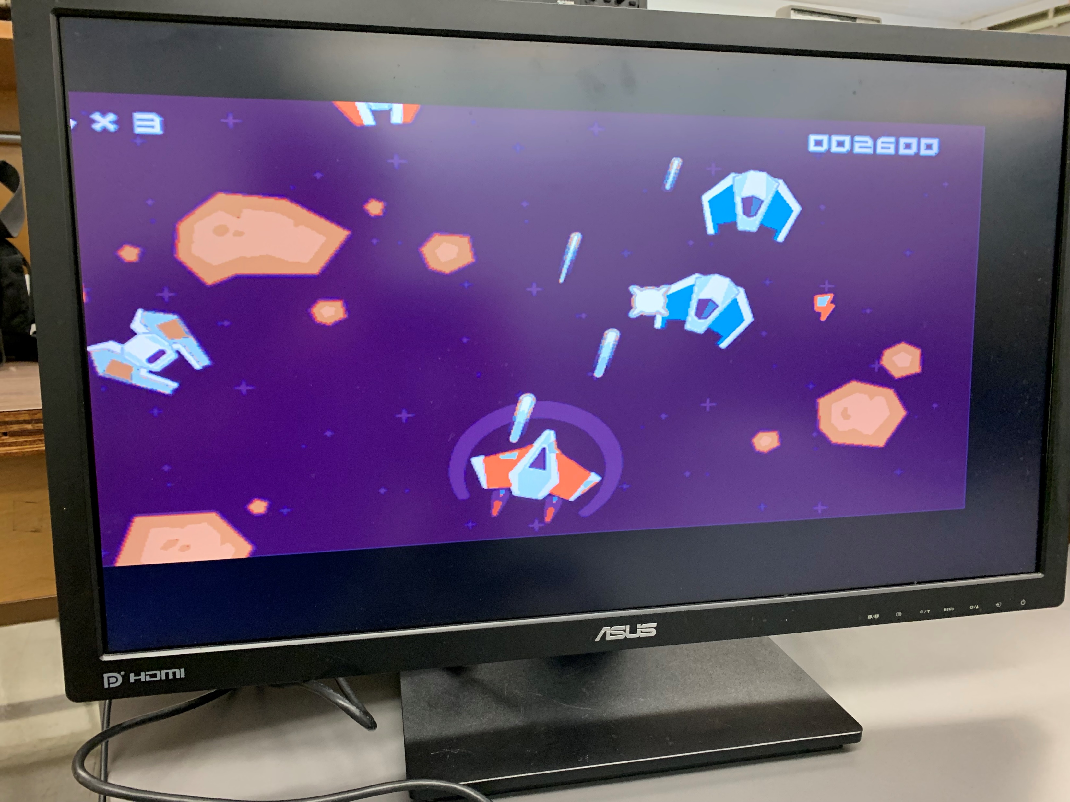

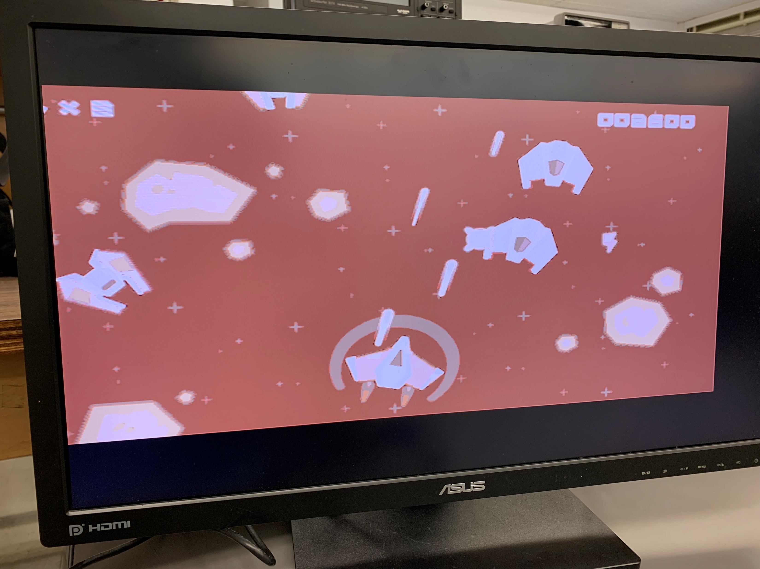
Image Encryption
Using the palette files as keys
Use a different palette file than the one created for the image
Original image cannot be regenerated without the correct palette file

Slide 11
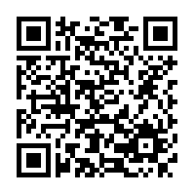
Github QR

